Slide 1

Reliable web hosting on raspberry pi: a self-adaptive approach
Group 7 – Arthur Li, Daniel Almeida

Slide 2
Problem Statement
Key Issues
Downtime
Inefficient resource allocation
Manual labor
Implications
Reduced user confidence
Operational Costs
Overprovisioning
Unrealized potential
Motivation
Remote location
Weather impact
Resource constrained

Slide 3
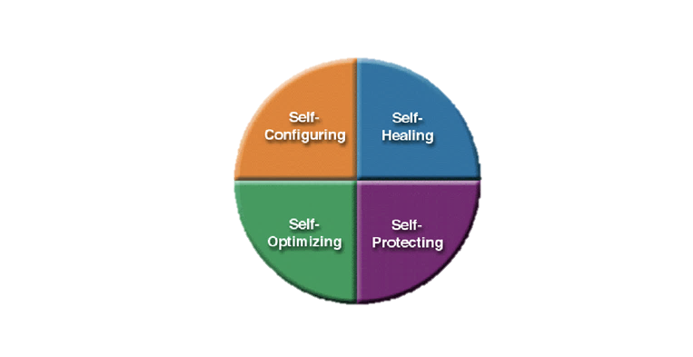
Proposed Solution
At its core: A self-adaptive web hosting framework
Framework: MAPE-K (Monitor, Analyze, Plan, Execute, Knowledge)
Mechanisms:
CPU clock speed adjustments
Content degradation
Watchdog timer
Apache caching
Anomaly detection model

Slide 4
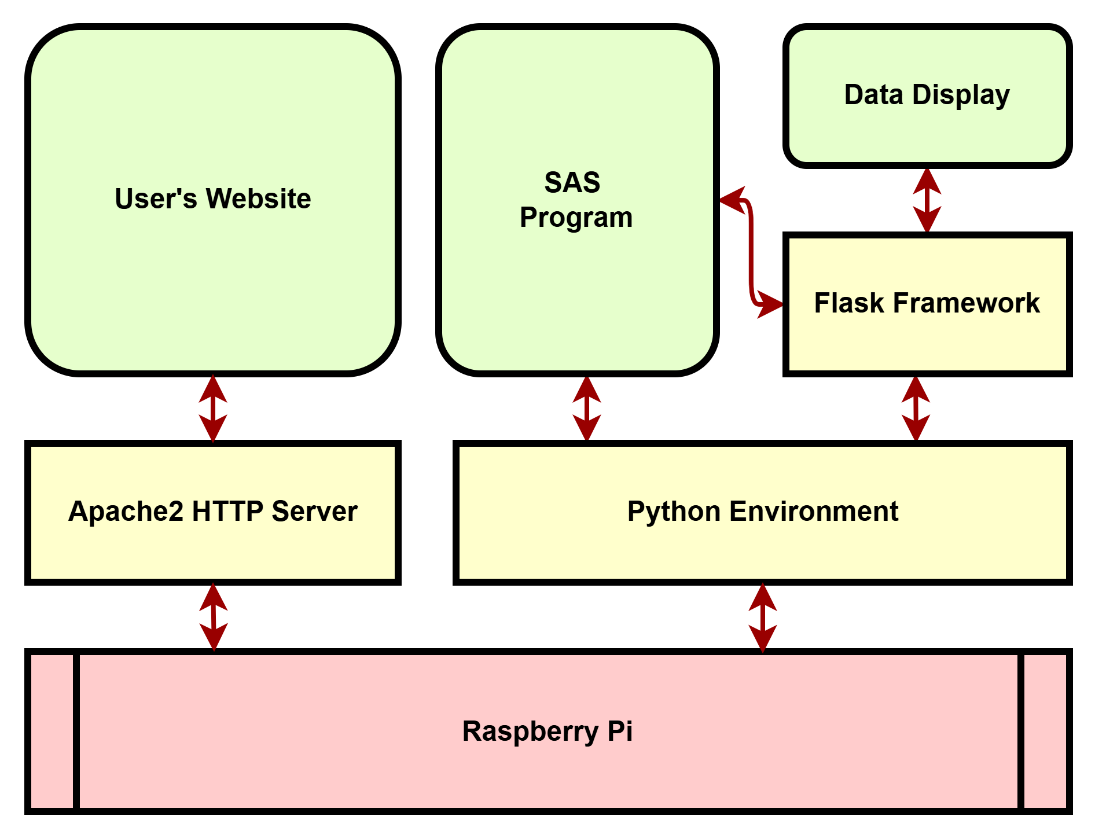
Proposed Solution

Slide 5
Results

Slide 6
Challenges and Future Work

Slide 7
References
[1] J. O. Kephart and D. M. Chess, "The Vision of Autonomic Computing," IEEE Computer Magazine, pp. 41-50, Jan. 2003
[2] L. Tahvildari, ECE750-T37: Engineering Self-Adaptive Software Systems, Lecture 1, Dept. of Elect. and Comp. Eng., University of Waterloo, 2024
[3] D. Weyns, An Introduction to Self-Adaptive Systems: A Contemporary Software Engineering Perspective, Wiley-IEEE CS Press, Oct. 2020

